Slide 1
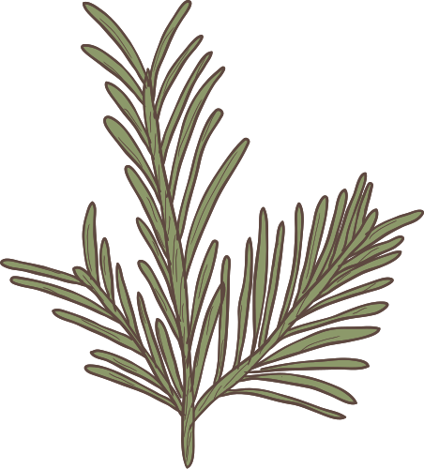


Title Slide
Title: Life on Land

Slide 2
SDG 15 seeks to protect, restore, and promote the sustainable use of terrestrial ecosystems.
Goal of Life on Land (SDG 15)
It includes managing forests, combating desertification, halting biodiversity loss, and protecting wildlife.

Slide 3
Forests – Earth’s Lungs
Forests store more than 80% of the world's terrestrial species.
They absorb roughly 2.6 billion tonnes of carbon dioxide each year. Home to over 1.6 billion people who depend on them for food, shelter, and livelihoods.

Slide 4
Over 2 billion hectares of land are currently degraded globally.
Global Land Degradation
About 75% of Earth’s land surface has been significantly altered by human activity. Soil erosion, desertification, and overgrazing reduce agricultural productivity.

Slide 5

Wildlife Under Pressure
Over 40,000 species are listed as threatened on the IUCN Red List.
Species like the Sumatran orangutan and Black Rhino face extinction due to habitat loss and poaching. Illegal wildlife trade is worth over $20 billion annually.

Slide 6
Desertification – A Silent Threat
Affects over 1 billion people worldwide.
Causes include overcultivation, deforestation, and poor irrigation practices. Leads to food insecurity and migration.

Slide 7


Case Study – The Amazon Rainforest
Known as the “lungs of the Earth”, it produces 20% of the world's oxygen.
Facing rapid deforestation: over 10,000 sq km lost per year. Critical to global biodiversity and carbon balance.

Slide 8
Solutions and Strategies
Agroforestry and sustainable agriculture
Protected areas and national parks Restoration of degraded land through rewilding and planting native species International cooperation (e.g., UNCCD, REDD+)

Slide 9
How You Can Help
Support conservation NGOs and eco-certified products
Reduce meat consumption to lower land use pressure Volunteer for local clean-up or planting events Use digital documents to save paper

Slide 10
Final Thought
“If we lose our forests and biodiversity, we lose our future.”

